Slide 1
An Introduction to Software Engineering

Slide 2
Features of Software different from others things
Software is a logical rather than a physical system element.
Software is developed or engineered; it is not manufactured in classical sense.
Software doesn’t “wear out.”
Although the industry is moving toward component-based construction, most software continues to be custom-built.

Slide 3
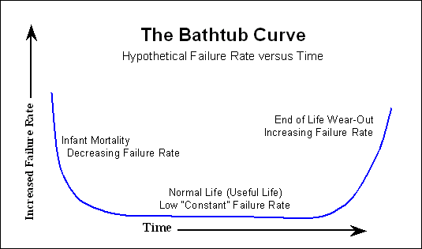
Hardware Failure Rate

Slide 4

Wear vs. Deterioration

Slide 5
System software
a collection of programs written to service other programs.
Some system software processes complex, but determinate information structures.
e.g., compilers, editors, and file management utilities
Other systems applications process largely indeterminate data
e.g., operating system components, drivers, networking software, telecommunications processors

Slide 6
Application software
Stand-alone programs that solve a specific business need.
Applications in this area process business or technical data in a way that facilitates business operations or management/technical decision making.
e.g., point-of-sale transaction processing, real-time manufacturing process control

Slide 7
Engineering/scientific software
has been characterized by “number crunching” algorithms.
Applications range from astronomy to volcanology, from automotive stress analysis to space shuttle orbital dynamics, and from molecular biology to automated manufacturing.

Slide 8
Embedded software
resides within a product or system and is used to implement and control features and functions for the end user and for the system itself.
Embedded software can perform limited and esoteric functions.
e.g., key pad control for a microwave oven, digital functions in an automobile such as fuel control, dashboard displays, and braking systems

Slide 9
Product-line software
designed to provide a specific capability for use by many different customers.
Product-line software can focus on a limited and esoteric marketplace or address mass consumer markets .
e.g., inventory control products, word processing, spreadsheets, computer graphics.

Slide 10
WebApps
this network-centric software category spans a wide array of applications. In their simplest form, WebApps can be little more than a set of linked hypertext files that present information using text and limited graphics.
as Web 2.0 emerges, WebApps are evolving into sophisticated computing environments that not only provide stand-alone features, computing functions, and content to the end user, but also are integrated with corporate databases and business applications.

Slide 11
AI
Makes use of non-numerical algorithms to solve complex problems that are not amenable to computation or straightforward analysis.
Applications within this area include robotics, expert systems, pattern recognition (image and voice), artificial neural networks, theorem proving, and game playing

Slide 12
New Challenges for SE
Open-world computing
Netsourcing
Open source

Slide 13
Open-world computing
the rapid growth of wireless networking may soon lead to true pervasive, distributed computing.
The challenge for software engineers will be to develop systems and application software that will allow mobile devices, personal computers, and enterprise systems to communicate across vast networks.

Slide 14
Netsourcing
he World Wide Web is rapidly becoming a computing engine as well as a content provider.
The challenge for software engineers is to architect simple (e.g., personal financial planning) and sophisticated applications that provide a benefit to targeted end-user markets worldwide.

Slide 15
Open source
a growing trend that results in distribution of source code for systems applications, so that many people can contribute to its development.
The challenge for software engineers is to build source code that is self-descriptive, but more importantly, to develop techniques that will enable both customers and developers to know what changes have been made and how those changes manifest themselves within the software.

Slide 16
Software Process
A process is a collection of activities, actions and tasks that are performed when some work product is to be created.
It is not a rigid prescription for how to build computer software. Rather, it is an adaptable approach that enables the people doing the work to pick and choose the appropriate set of work actions and tasks.
Purpose of process is to deliver software in a timely manner and with sufficient quality to satisfy those who have sponsored its creation and those who will use it.

Slide 17
Five Activities of a Generic Process framework
Communication: communicate with customer to understand objectives and gather requirements
Planning: creates a “map” defines the work by describing the tasks, risks, resources, work products and work schedule.
Modeling: Create a “sketch”, what it looks like architecturally, how the constituent parts fit together and other characteristics.
Construction: code generation and the testing.
Deployment: Delivered to the customer who evaluates the products and provides feedback based on the evaluation.
These five framework activities can be used to all software development.
For many software projects, these framework activities are applied iteratively as a project progresses.

Slide 18
Umbrella Activities
Complement the five process framework activities and help team manage and control progress, quality, change, and risk.
Software project tracking and control: assess progress against the plan and take actions to maintain the schedule.
Risk management: assesses risks that may affect the outcome and quality.
Software quality assurance: defines and conduct activities to ensure quality.
Technical reviews: assesses work products to uncover and remove errors before going to the next activity.
Measurement: define and collects process, project, and product measures to ensure stakeholder’s needs are met.
Software configuration management: manage the effects of change throughout the software process.
Reusability management: defines criteria for work product reuse and establishes mechanism to achieve reusable components.
Work product preparation and production: create work products such as models, documents, logs, forms and lists.

Slide 19
A Generic Process Model
As we discussed before, a generic process framework for software engineering defines five framework activities-communication, planning, modeling, construction, and deployment.
In addition, a set of umbrella activities- project tracking and control, risk management, quality assurance, configuration management, technical reviews, and others are applied throughout the process.
Next question is: how the framework activities and the actions and tasks that occur within each activity are organized with respect to sequence and time?

